Slide 1
Recipes and Ingredients for Neutrino Mass at Loop Level
Yasaman Farzan IPM , Tehran

Slide 2
Neutrino mass<< Electron mass

Slide 3
Neutrino mass<< Electron mass
Who cares?!

Slide 4
Neutrino mass<< Electron mass
Who cares?!
Let’s try to explain

Slide 5
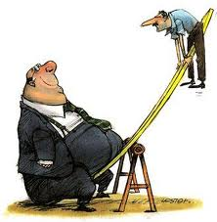
new mass scale
Seesaw type I

Slide 6
Loop suppression
Zee model
Babu model
Symmetries to forbid lower order contribution
Dark matter

Slide 7
Some examples
SLIM model
)C. Boehm, Y. F., T. Hambye, S. Palomares-Ruiz1
and S. Pascoli, PRD 77 (2008) 43516;
2) Y.F., PRD 80 (2009)
3) Y.F. and M. Hashemi, JHEP 2008
4) Y.F., Mod Phys Lett A25 (2010)
AMEND
5) Y.F., S. Pascoli and M. Schmidt, JHEP 2010
Scotogenic model
Y.F. AND E. MA, PRD (2012)
Recipes and ingredients for neutrino mass at loop level
YF, Silvia Pascoli and Michael Schmidt

Slide 8
SLIM scenario
New fields:
Majorana Right-handed neutrino
SLIM=Scalar as LIght as MeV
Effective Lagrangian:
New parameters:

Slide 9
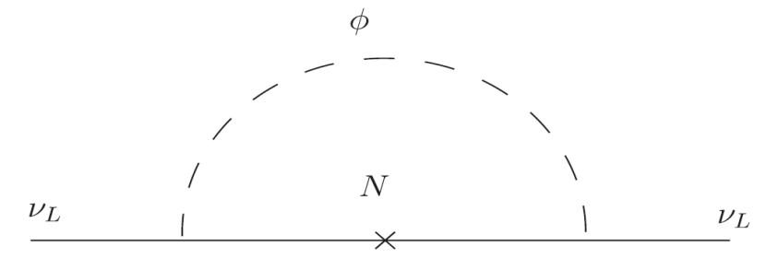
neutrino masses
In this scenario, SLIM does not develop any VEV so the tree level neutrino mass is zero.
Radiative mass in case of real scalar:
Ultraviolet cutoff

Slide 10
SLIM as a real field
symmetry:

Slide 11
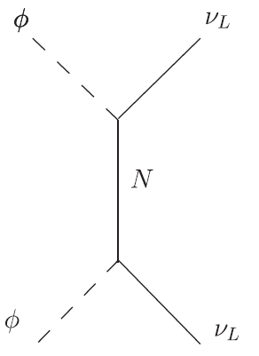
Annihilation cross-section

Slide 12
Linking dark matter and neutrino mass

Slide 13
Bounds on SLIM mass

Slide 14
A way to test the scenario

Slide 15
Lower bound on coupling
+
upper bound on masses of new particles

Slide 16
Lower bound on coupling
+
upper bound on masses of new particles
Model is falsifiable by low energy high intensity experiments (luminosity frontier)

Slide 17
An economic model embedding real SLIM
YF, “Minimal model linking two great mysteries: Neutrino mass and dark matter”, PRD 2009

Slide 18
An electroweak singlet scalar,
Two (or more) Majorana right-handed neutrinos
A scalar electroweak doublet

Slide 19
Light and heavy
Light sector: Dark matter candidate and
(Supernova, meson decay and ...)
Heavy sector:

Slide 20
Interesting aspect
Neutrino mass
LHC

Slide 21
AMEND
Y.F., S. Pascoli and M. Schmidt, JHEP 201
AMEND: A Model Explaining Neutrino mass and Dark matter

Slide 22
AMEND: A Model Explaining Neutrino mass and Dark matter
Content:
A singlet of SU(2)
Fermionic doublets
A scalar triplet of SU(2) with hypercharge

Slide 23
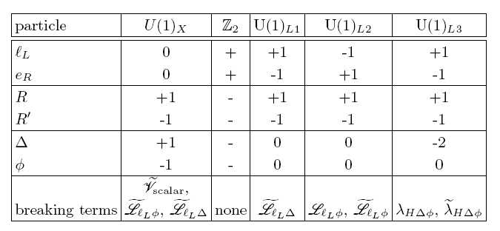

Slide 24
symmetry
SM fields SM fields
New fields -(New fields)
The lightest of new particles is stable and a suitable dark matter candidate.

Slide 25
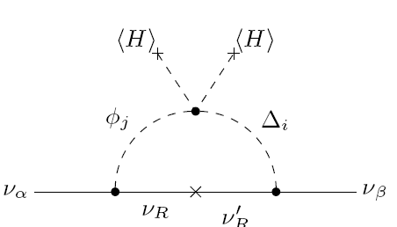

Slide 26
Interesting aspect
Neutrino mass
LHC
Couplings

Slide 27
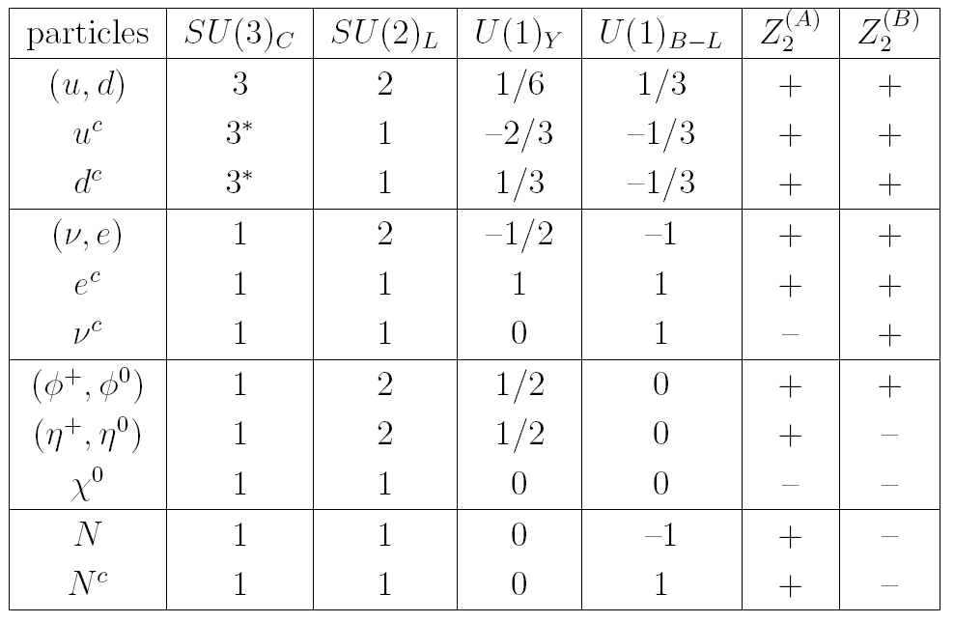
Dirac neutrino mass generation from dark matter
Y.F. and Ma, PRD (2012)
(see also Gu and Sarkar PRD77 (2008))

Slide 28
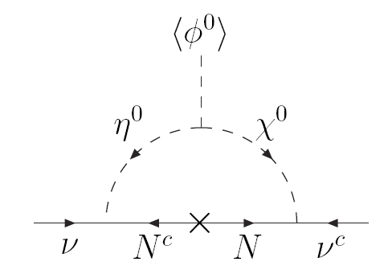
Neutrino mass generation

Slide 29
Next topic
General rules for model building
Recipes and ingredients for neutrino mass at loop level
YF, Silvia Pascoli and Michael Schmidt

Slide 30
Main Lagrangian
Without loss generality: Only left-handed fermions

Slide 31
Constraining symmetry
A symmetry to forbid lower order correction
What general rules on topology

Slide 32
Symmetry

Slide 33
Assumption
All the SM particles transform trivially under the constraining symmetry.
ONLY the SM Higgs obtains a VEV
No broken discrete symmetry
No Domain wall
Dark matter

Slide 34
Loops giving rise to Weinberg operator

Slide 35
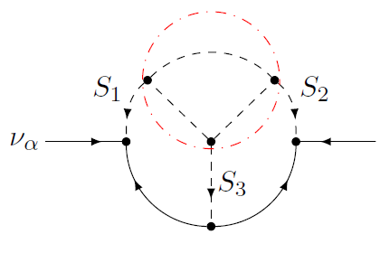
Possible ways

Slide 36
One-loop contribution

Slide 37
Reduction to one-loop

Slide 38
Reduction to one-loop

Slide 39
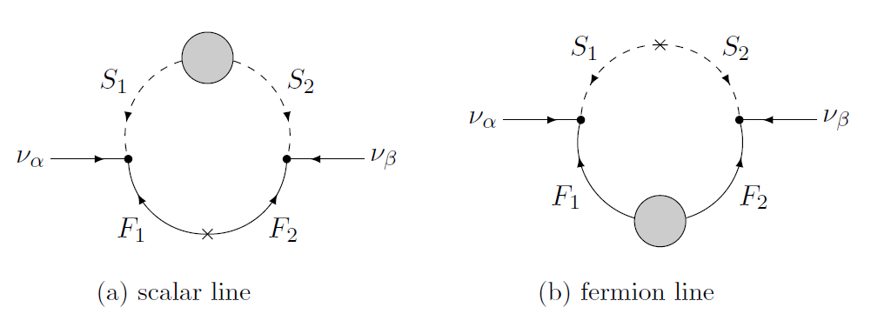
Wave function renormalization

Slide 40
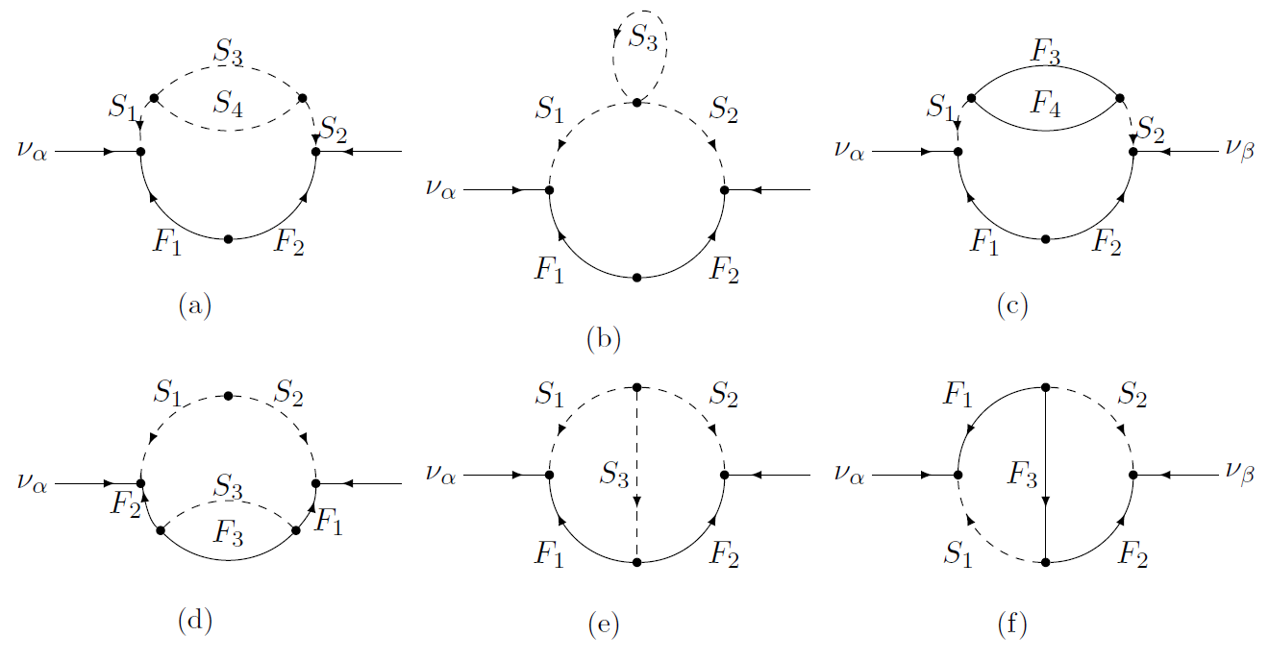
Two loop

Slide 41
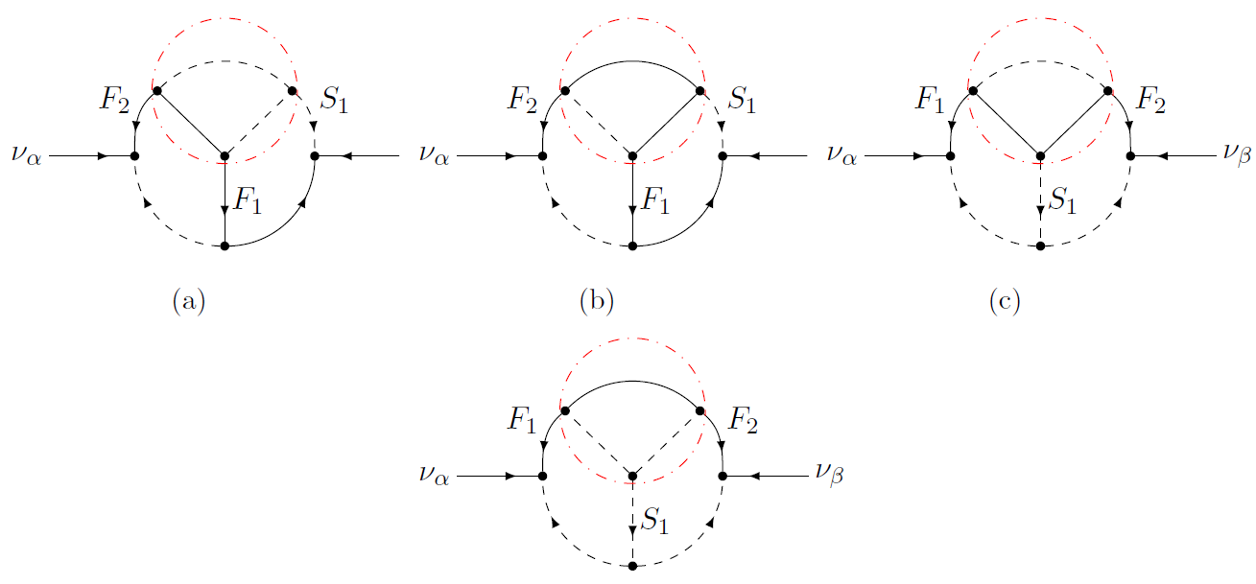
Three loops (accompanied)

Slide 42
Three loop (accompanied)

Slide 43
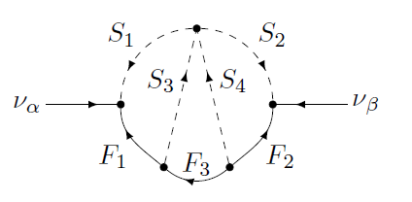
Three loop (unaccompanied)

Slide 44
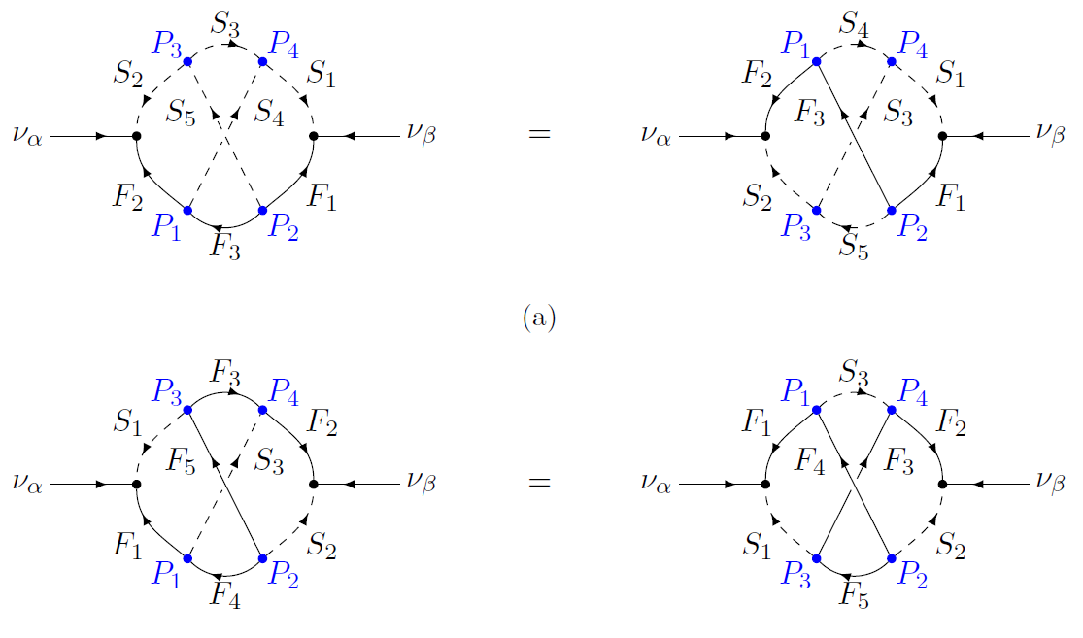
Three loop (unaccompanied)

Slide 45
Some interesting result
Smallest Abelian discrete symmetry to render them :
unaccompanied

Slide 46
Fourth and higher loops are too suppressed.

Slide 47
Summary
Loop level neutrino mass with constraining symmetry
Dark matter
LHC and LFV (and perhaps g-2)
Several model: SLIM, AMEND, DIRAC Scotogenic

